Slide 1
APAD
_{ARP Poisoning Attack Detector}
John Bilella, Nick Lara, Nick Masci
Advisor: Dr. Fu

Slide 2
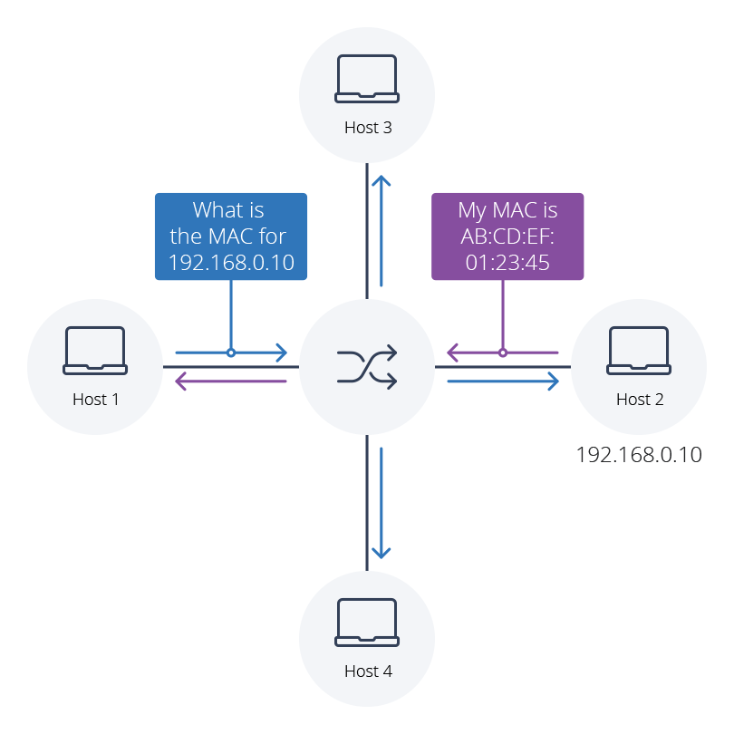
What is ARP?
ARP - Address Resolution Protocol
Pairs IP address to the proper MAC address
IP - Internet Protocol
Number assigned to each device on a network, by the network
MAC - Media Access Control address
Unique number inherent to an individual device’s hardware
Image from: https://www.auvik.com/wp-content/uploads/2021/04/ARP-table-diagram.png
Notes:
Imagine you are waiting for an important package in the mail. Perhaps this package contains money, something you’ve ordered, or some other personal information. Now, imagine that somebody switched the numbers on their house to match yours. Your important package is instead delivered to that person’s house! They used your identity to intercept and steal your package.
Similarly, ARP Poisoning is a cyber attack where a hacker tricks one device into sending messages to the hacker instead of the intended recipient, allowing the hacker to gain access to that devices’ communications and sensitive data.
ARP
The ARP connects an IP, that may change, to a MAC, which will always remain unique per-device
The ARP table is used to keep track of all these connections
IP
A number assigned to each device on a network in order to indicate which traffic goes to what device. This may change periodically during normal operation, but this change is expected.
Example - “A person's house or apartment number”
MAC
The unique number assigned to the hardware of a device.
Example - “The physical house/apartment itself”

Slide 3
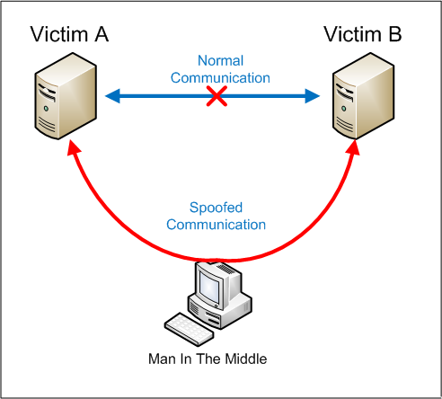
ARP Poisoning?
Man in the Middle attack (MITM)
Analyzes victim’s network connection
Can give attackers vital information
Unencrypted data
May be carried out by anyone
Cybersecurity platform Crowdstrike considers ARP poisoning attacks the fourth most common type of cyber attack today^{[1]}.
Image: https://www.researchgate.net/figure/Man-in-the-middle-attack-model_fig3_342618239
Source [1]: https://www.crowdstrike.com/cybersecurity-101/cyberattacks/most-common-types-of-cyberattacks/#4.%20Spoofing

Slide 4
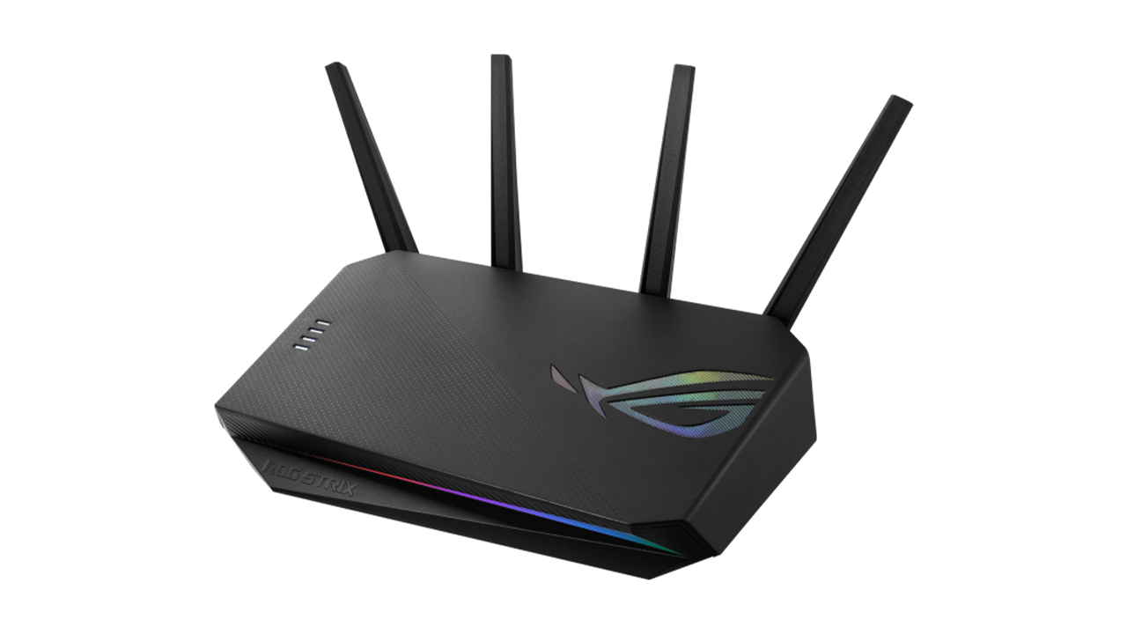
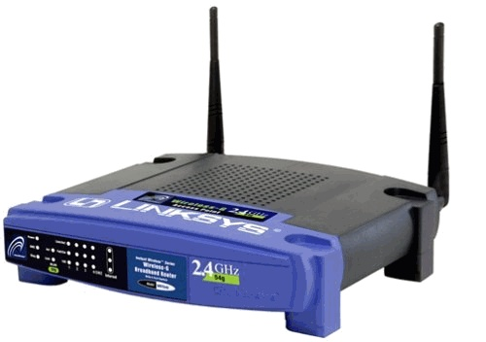


Existing Solutions and their Limitations
Many modern network routers can identify a change to the ARP table without any additional software
What if you are using an outdated router, with no way to protect from these attacks?
Image 1 (Old router): https://images.squarespace-cdn.com/content/v1/52b9f067e4b0a5849fd7231d/1387938054538-OTP7X3HZNWI40UERC9GF/wrt54g.jpg
Image 2 (Modern router): https://i.pcmag.com/imagery/reviews/06OgPGoOx7nvGVK6BGvRThv-5.fit_lim.size_840x473.v1638993428.png
Image 3 (Warning sign clipart): https://www.pngmart.com/files/17/Warning-Sign-PNG-Image.png
Image 4 (Blue shield clipart): https://freepngimg.com/thumb/shield/23485-2-blue-shield-clip-art.png

Slide 5
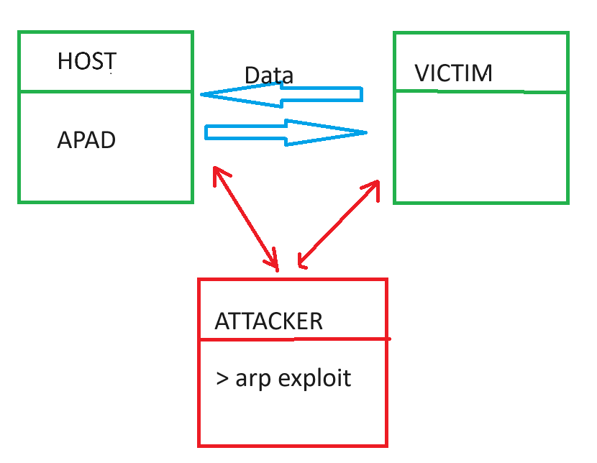
Our Vision
Successfully develop a “Detection Tool” program that allows a user to detect an attack, regardless of what hardware they have
A change in the ARP table will result in an ALERT
We do not want to alert on a legitimate user being added to the network

Slide 6
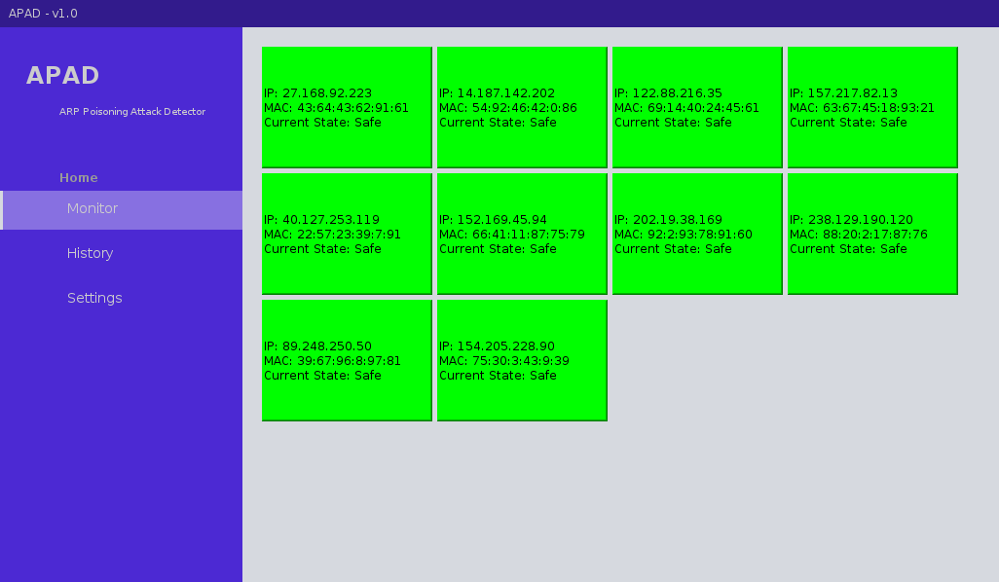
Our Goals
Easy-To-Read User Interface
Detect a threat as soon as possible
Maintain a running log for a historical reference

Slide 7
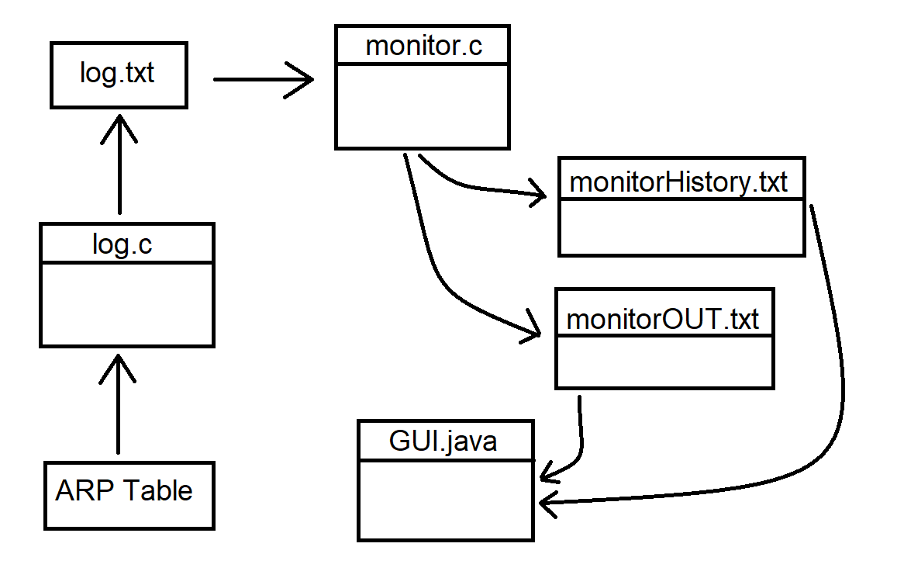
Project Design
monitor.c and log.c written in C
Using libpcap library to capture and analyze network packets
UI written in Java
Netbeans IDE and Java Swing
Open-source template UI
Settings are handled within the UI only
No login required
Program should be installed on all devices in network

Slide 8
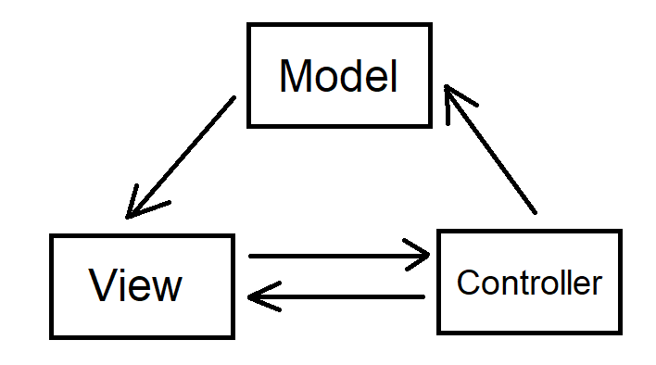
Project Design (cont.)
Model-View-Controller (MVC)
Our Software utilizes the Model-View-Controller design pattern.
Model - log.c; core data retrieval and manipulation
View - User Interface; displays information to the user and accepts user input
Controller - monitor.c; intermediary between the model and the view.
Interacts with the model to retrieve the ARP table
Updates the view when it detects an attack.
Notes:
Model - log.c is the model as it is the core data retrieval and manipulation, since it reads the ARP table from the host computer and extracts the IP/MAC address pairings.
View - Our java netbeans frontend is the view because it is the graphical user interface that users interact with. It displays information to the user and accepts user input.
Controller - monitor.c is the controller, as it is the intermediary between the model and the view. It both interacts with the model to retrieve the ARP table and updates the view when it detects an attack.

Slide 9
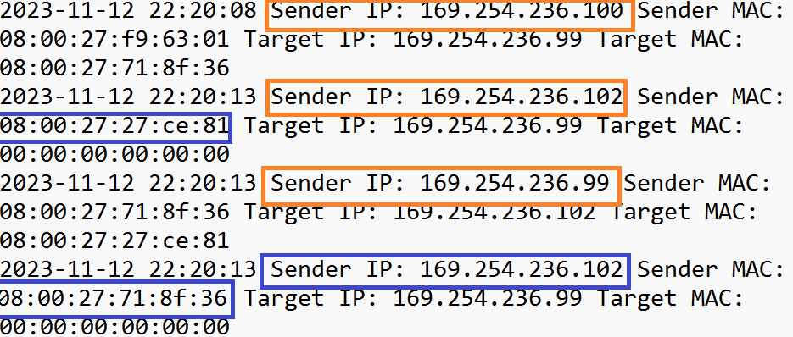
Methods
Step 1 - Read network data
Step 2 - Add each IP/MAC pairing to an array of devices
Step 3 - If a MAC address appears in the network traffic that has already been mapped to another IP address, ALERT on attack

Slide 10
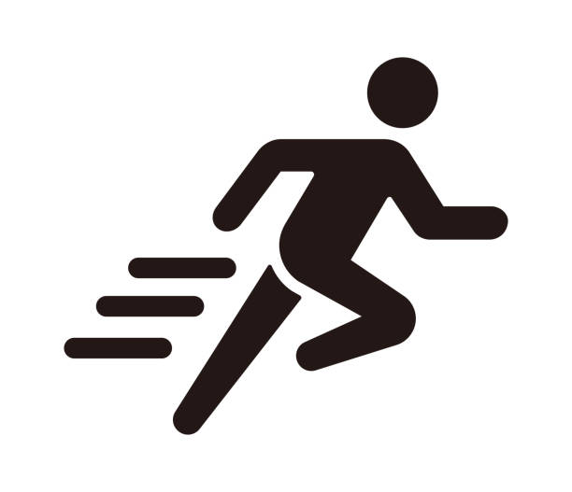
Sprints Overview
 | Goal | Demo Goal | Scrum Master
Sprint 1 | Skeletal user interface; basic functionality of monitor and log programs | Show UI creating randomly-generated nodes and monitor.c running by modifying a text file to simulate an “attack” | Nico L
Sprint 2 | Compatibility work with UI and monitor; testing of actual ARP attack against monitor | Show a real ARP poisoning attack getting detected and blocked by monitor.c | Nick M
Sprint 3 | Add settings to UI, decide on a project name, and final tests | Show full program in final state; attack from start to finish | John B
Image from: https://media.istockphoto.com/id/1225549108/vector/run-sport-exercise-vector-icon-illustration.jpg?s=612x612&w=0&k=20&c=RKFqwoj4U4mw076yakzLoxFxz5MLm1gQI_mU4RVpzp4=

Slide 11
Sprint 1
Goal: Skeletal user interface; basic functionality of monitor and log programs
Demo Goal: Show UI creating randomly-generated nodes and monitor.c running by modifying a text file to simulate an “attack”
Team Member | Tasks | Notable Issues
Nico L | Get UI running in Virtual Machines and begin work on displaying network event history in the UI | Netbeans not recognizing UI template file; verified proper file was being downloaded and used
Nick M | Develop node-drawing functions in UI; Get from generating random nodes to creating them from data output by monitor program | Nodes as buttons not changing color immediately; used different Swing object to display information
John B | Get log.c and monitor.c to a runnable state; begin work on compatibility between monitor.c and UI | Virtual machine was missing system files to compile log.c; reinstalled necessary files and compiled properly
Image from: https://media.istockphoto.com/id/1225549108/vector/run-sport-exercise-vector-icon-illustration.jpg?s=612x612&w=0&k=20&c=RKFqwoj4U4mw076yakzLoxFxz5MLm1gQI_mU4RVpzp4=

Slide 12
Sprint 2
Goal: Compatibility work with UI and monitor; testing of actual ARP attack against monitor
Demo Goal: Show a real ARP poisoning attack getting detected and blocked by monitor.c
Team Member | Tasks | Notable Issues
Nico L | Complete framework to display network history in UI, then research and test ARP poisoning attack via Ettercap | Netbeans was somewhat difficult to work with displaying data; got help from groupmates
Nick M | Use Nico’s framework to fully add history tab to UI; debug compatibility issues and polish code | monitor.c was crashing upon being run, but using gdb to investigate the problem allowed us to solve it
John B | Make monitor.c read output of log.c, make monitor.c block incoming threats, and have monitor.c output a file to be used in the UI’s history tab | The original intention was to block based off changed IP addresses, but the Ettercap attack changes MAC addresses. Code was reworked to account for this
Image from: https://media.istockphoto.com/id/1225549108/vector/run-sport-exercise-vector-icon-illustration.jpg?s=612x612&w=0&k=20&c=RKFqwoj4U4mw076yakzLoxFxz5MLm1gQI_mU4RVpzp4=

Slide 13

Sprint 3
Goal: Add settings to UI, decide on a project name, and final tests
Demo Goal: Show full program in final state; attack from start to finish
Team Member | Tasks | Notable Issues
Nico L | Assist group members in setting up demo environment and teaching how to perform the attack properly | No notable issues
Nick M | Add settings to UI, then rigorously test demo environment from start to finish | History tab needed more detailed output; with John’s help, modified monitor.c to include output for when attacks are detected
John B | Fix bugs in monitor.c and log.c and ensure stability of the programs | Got a new laptop; had to spend time setting up virtual machines and demo environment again
Image 1 (Sprinting figure): https://media.istockphoto.com/id/1225549108/vector/run-sport-exercise-vector-icon-illustration.jpg?s=612x612&w=0&k=20&c=RKFqwoj4U4mw076yakzLoxFxz5MLm1gQI_mU4RVpzp4=
Image 2 (Checkered flag): https://i.etsystatic.com/19543171/r/il/a1fe46/5195479644/il_fullxfull.5195479644_7zpm.jpg

Slide 14
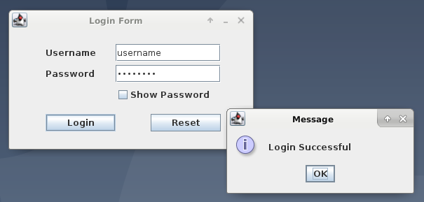
Risks and Changes
Original concept included a login system
Program would only be used by a network administrator
The final application does not include this
Meant to be installed on all devices in the network
Log-in UI
concept

Slide 15
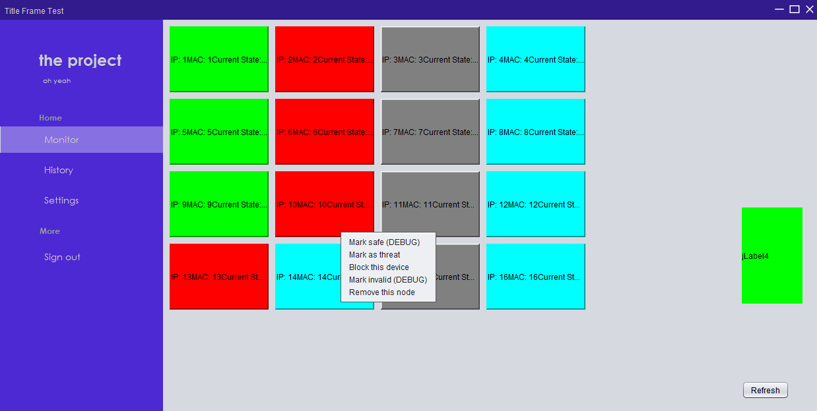
Risks and Changes
Original concept included right-click menus
Prompt to manually block attacks when they are detected
Realistically, attacks should be blocked automatically
Right-click interactions were removed.
Early UI test
with right-click
menu still implemented

Slide 16

Testing
We utilized the techniques of integration testing and regression testing while developing our software.
Components of our software were tested separately before being gradually integrated.
After integration, we ran our software again using our test cases to ensure that no prior functionality was lost.
Image from: https://cdn-icons-png.flaticon.com/512/1199/1199104.png

Slide 17

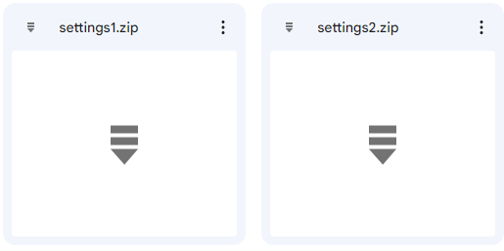
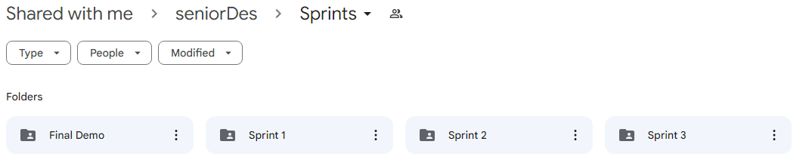

Team Experience
John and Nico were primarily in charge of monitor.c and log.c, while Nick was primarily in charge of the UI.
Each person only really understood their own code
Had to wait on other group members in order to fix any issues encountered
Meetings were held over Discord, or in-person, usually after meeting with Advisor
Discord allowed us to communicate despite wildly varying schedules
Uploaded and shared files over Google Drive, allowing us to keep track of old versions
By the time we realized we probably should have used GitHub, it was too late
Discord Logo from: https://www.videogameschronicle.com/files/2021/05/discord-new-logo.jpg

Slide 18

Conclusions
Throughout this project, we learned:
The importance of communication in a team setting.
Adaptability, compromise, and project planning are all paramount to success.
Scrapping old UI for a newer, open-source template
What it’s like to work in a fast-paced, real-world type of work environment.
Image from: https://media.istockphoto.com/id/1149246206/vector/light-bulb-with-rays-lighting-electric-lamp-creative-idea-solution-thinking-concept.jpg?s=612x612&w=0&k=20&c=MKFLk7zJSL1LcS1E91ujw8hnoMdAj5scM_QOEhiIkgI=
Notes:
First bullet: Keeping track of who’s working on what. There were some problems that not everyone was available to deal with. Sometimes Nico had to stay after class to help John with a problem he was dealing with with his computer. Sometimes Nick and Nico had to stay up late trying to fix the UI. Sometimes John and Nick would be messaging each other back and forth on Discord with updated code.
Second bullet: There were times we had to come up with new plans on the fly. For instance, we had to scrap our original UI we started on last semester in favor of modifying an open-source premade template that had a more modern feel. All three of us had our own unique vision of what the software should look like on day 1, and each day we worked that vision would change ever so slightly.

Slide 19
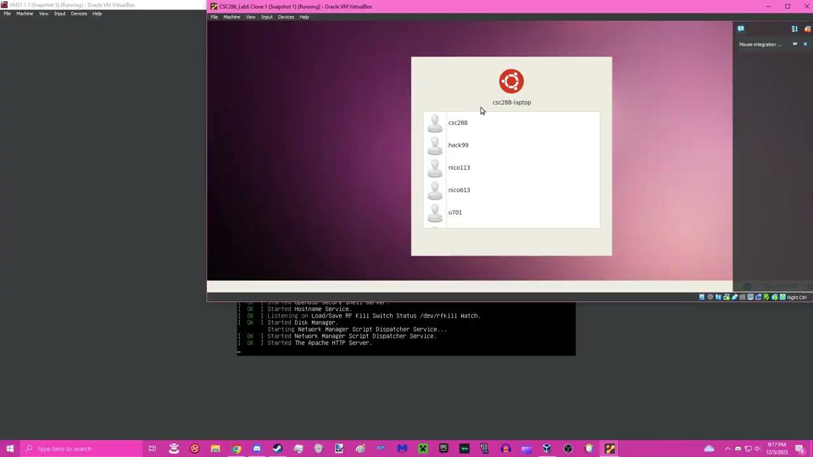
Demo and Results

Slide 20
Thank you
Any questions?

